Slide 1

Conditional Sentences
TCS Placement Practice
Dr. Nitin H. Chauhan
Humanities and Science Department
nitin.chauhan@darshan.ac.in
9016705547

Slide 2

Looping
Topics
  Conditional Sentences

Slide 3
Conditional Sentences
Notes:
Gif Reference: https://tenor.com/view/tkthpsharma-gif-23317246

Slide 4
Conditional Sentences
Conditional sentences are sentences that talk about a condition (something that might happen, or might have happened) and the result (what follows from that condition).
શરતી વાક્ય એવા વાક્ય હોય છે જે કોઈ શરત (જે બનવાનું હોય તે) અને તેનું પરિણામ (તે શરત પૂર્ણ થવાથી શું થાય છે) દર્શાવે છે.
Conditional sentences are also called if-clauses.
They usually have two parts:
If it rains, I will stay home.
જો વરસાદ પડે, તો અમે ઘરમાં રહીશું.
If-clause
(condition)
Main clause
(result)
જો વાક્ય
(શરત)
મુખ્ય વાક્ય
(પરિણામ)

Slide 5
Types of Conditional Sentences
Types of Conditional Sentences
Zero Conditional
First Conditional
Second Conditional
Third Conditional

Slide 6
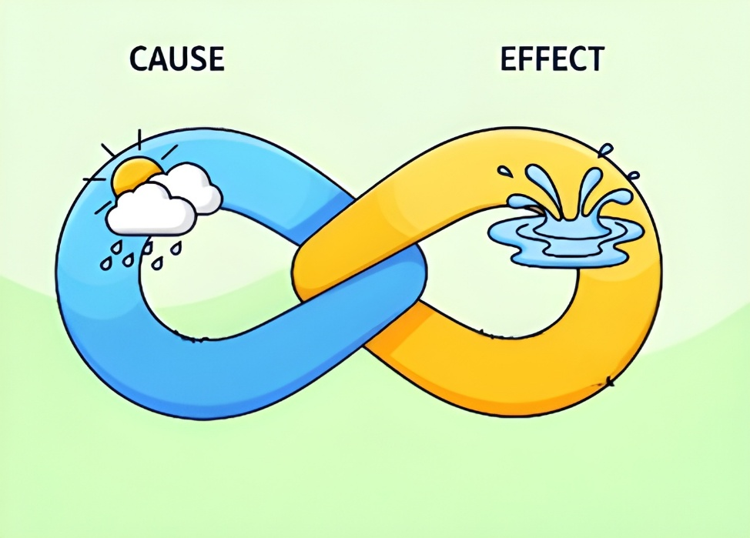
Conditional Sentences – Zero Conditional
Zero Conditional Sentences are used to express general truths, facts, laws of nature, or regular habits, things that are always true when the condition is met.
If it rains, the ground gets wet.
Structure:
Usage:
  Used for universal truths, scientific facts, habits, or rules.
  The result is always the same whenever the condition happens.
  The sentence uses present tense, and it talks about things that are
  always true.
If
+
Simple Present Tense
+
Simple Present Tense

Slide 7
Conditional Sentences – Zero Conditional
Examples:
  If you mix red and blue, you get purple.
  If children eat too much sugar, they get cavities.
  If you press this button, the machine starts.
  If you heat water to 100°C,
  If I don’t water the plants,
  If people eat too much junk food,
Note:
  "If" can often be replaced by "when" in zero conditionals without changing the meaning.
    If you heat ice, it melts.
    When you heat ice, it melts.
it boils.
they die.
  they get sick.

Slide 8
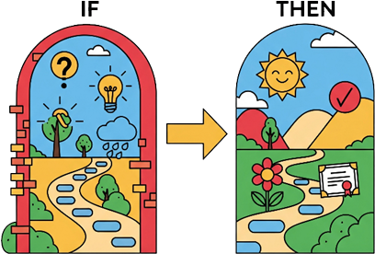
Conditional Sentences – First Conditional
First Conditional Sentences are used to talk about a probable or possible future event and its likely result.
If you take the first step, you will unlock success.
Structure:
Usage:
  Talks about real and possible situations in the future.
  Condition is realistic; the result is expected if the condition is fulfilled.
If
+
Simple Present Tense
+
Simple Future Tense

Slide 9
Conditional Sentences – First Conditional
Examples:
  If it rains tomorrow, we will cancel the picnic.
  If you study hard, you will pass the exam.
  If you call her now, she forgive you.
  If I see her, I tell her the news.
  If she calls me, I help her.
  If you don’t eat breakfast, you be hungry later.
Note:
  Modal verbs can replace will:
    If you study, you will pass. → If you study, you may pass.
    If you are free, you can join us.
    If you finish on time, you may leave early.
  Imperative is also possible:
    If you see her, tell her to call me.
will
will
will
will

Slide 10
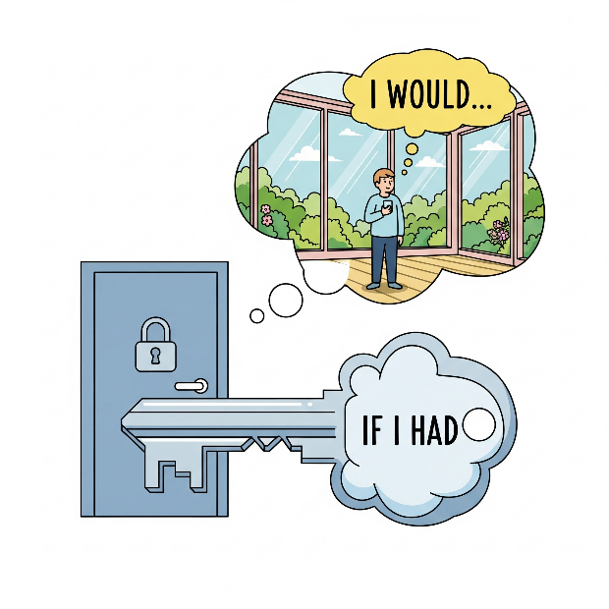
Conditional Sentences – Second Conditional
Second Conditional Sentences are used for imaginative or unlikely situations in the present or future. The condition is not true or is very unlikely to happen.
If I had the key, I would be in that house.
Structure:
Usage:
  To talk about imaginary, unlikely, or impossible situations in the present or future.
If
+
Simple Past Tense
+
Would
+
Main Verb

Slide 11
Conditional Sentences – Second Conditional
Examples:
  If I were rich, I would travel the world.
  If he studied more, he would get better grades.
  If she had a car, she would drive to work.
  If he had wings, he fly.
  If they invited me, I attend.
  If I knew his address, I visit him.
Note:
  We often use were instead of was in formal English:
    If I were you, I would talk to her.
would
would
would

Slide 12
Conditional Sentences – Third Conditional
Third Conditional Sentences are used to talk about a hypothetical past situation and its impossible result.
The condition was not met in the past, so the situation could not happen.
If he had told me the truth, I would have helped him.
Structure:
Usage:
  To talk about situations in the past that did not happen (regrets, criticisms, missed chances).
If
+
Past Perfect
+
Would Have
+
Past Participle

Slide 13
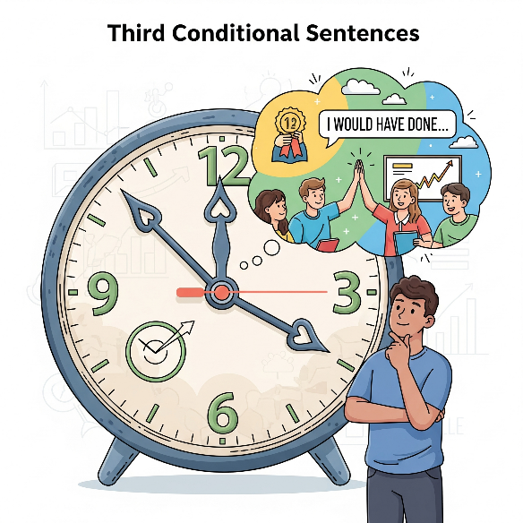
Conditional Sentences – Third Conditional
Examples:
  If I had studied harder, I would have passed the exam.
  If she had left earlier, she would have caught the train.
  If they had invited me, I would have attended the party.
  If he had listened, he made that mistake.
  If we had prepared better, we won the match.
  If the alarm had worked, we woken up on time.
Note:
  Used when the event cannot be changed (past is fixed).
  Often used in expressing blame/regret:
    If you had told me earlier, I would have helped you.
would not have
would have
would have

Slide 14
Comparison of Conditional Sentences
Comparison between Conditionals:
Type | If-Clause | Main Clause | Usage | Example
Zero Conditional | If + Present Simple | Present Simple | Facts, laws, general truths | If plants don’t get sunlight, they die.
First Conditional | If + Present Simple | Will + Verb (or may/can) | Real future possibilities | If you practice daily, you will improve quickly.
Second Conditional | If + Past Simple | Would + Verb | Unreal present/future | If I were you, I would accept the offer.
Third Conditional | If + Past Perfect | Would have + Past Participle | Unreal past (regrets) | If I had saved money, I would have bought a car.

Slide 15
Conditional Sentences Practice
Read each sentence carefully and write whether it is First Conditional, Second Conditional, or Third Conditional.
  If I had known about the sale, I would have bought the laptop.
  Third Conditional
  If she drinks too much coffee, she gets headaches.
  Zero Conditional
  I would visit Paris if I had enough money.
  Second Conditional
  If he practices regularly, he will improve his guitar skills.
  First Conditional
  If I were taller, I could play basketball professionally.
  Second Conditional

Slide 16
Conditional Sentences Practice
Each sentence below contains an error in its conditional form. Carefully read each one and rewrite it correctly.
  She would have call you if she knew about the meeting.
  She would have called you if she had known about the meeting. → Third Conditional
  If it rains yesterday, we will stay indoors.
  If it rained yesterday, we would have stayed indoors. → Third Conditional
  He would help you if he will have time.
  He would help you if he had time. → Second Conditional
  If I am taller, I could reach the shelf yesterday.
  If I were taller, I could reach the shelf. → Second Conditional
  If the train will be on time, we would not miss it.
  If the train is on time, we will not miss it.→ First Conditional

Slide 17
Thank You

